Slide 1

Artificial Neural Networks - Project
W12AIR-SM0721P
Wine quality classification using Artificial Neural Network
Presentation1
Autors in group:
Paweł Ozga
Pranav Pramod

Slide 2
Milestone
Presentation 1 (25.03.2025) Topic - Wine quality classification using ANN.
(8.04.2025/6.05.2025) Prepare code to next presentation.
Presentation 2 (20.05.2025) Multilayer prescription, function, back propagation etc.
(20.05.2-25/3.06.2025) Preprocessing set Test/Train/Validation.
Presentation 3 (17.06.2025) Project - Solution.

Slide 3
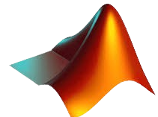


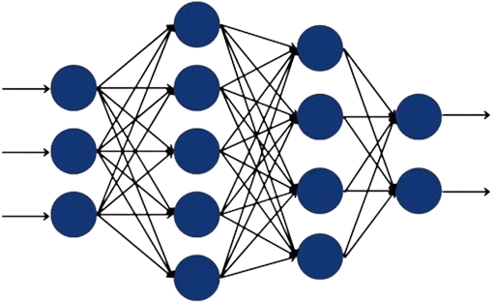
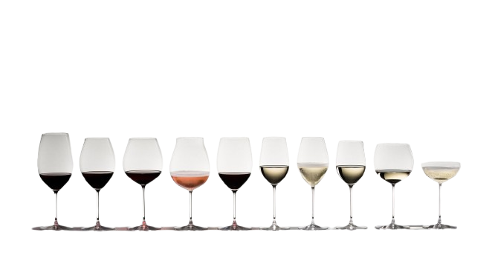
MATLAB Toolbox: Statistics and Machine Learning & Deep Learning
EXCEL Dataset : We train our model using DATASET (with numerous variables) containing various wine sample with features.
INPUT
(features)
OUTPUT
(classes)
Dateset : by Andrewmchen and Mateiz from GitHub
link: https://github.com/mlflow/mlflow-example/blob/master/wine-quality.csv

Slide 4
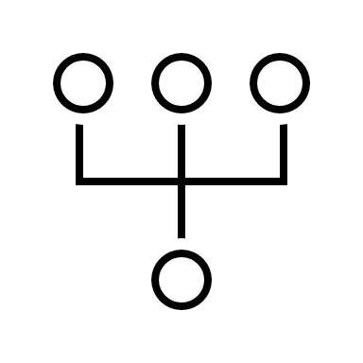


Division of responsibilities
Paweł Ozga
Pranav
Research about MLP network
Effect of Bias in Neural Network
Back propagation
Levenberg – Marquardt algorithm
Coding: both
Model Development & training
Documentation & presentation
Dataset & Handling
Coding: both
Model Development & training
Documentation
Preprocessing
Presentation
all

Slide 5

END PRESENTATION 1
Presentation1

Slide 6
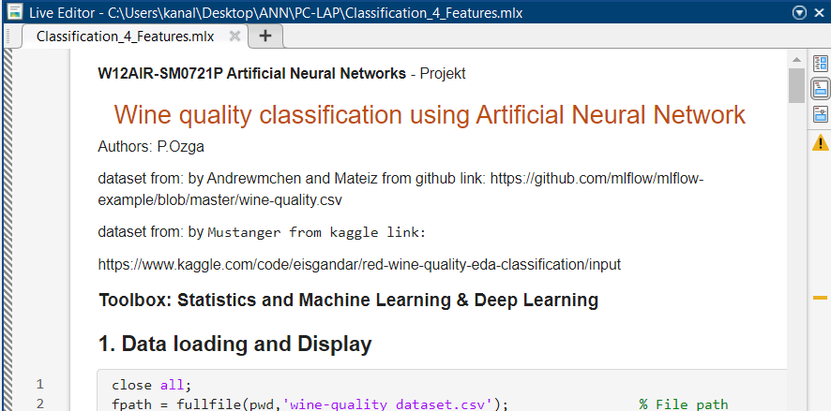
DATASET PREPARATION, BUILDING NETWORK, DISPLAYING RESULT
Presentation2
…

Slide 7
RESEARCH FOR DATABASE & SIMILAR SOLUTION
Kaggle:
🍷 Red Wine Quality ~ EDA & Classification, by Mustanger:
https://www.kaggle.com/code/eisgandar/red-wine-quality-eda-classification
Stochastic Gradient Descent, By Ryan Holbrook:
https://www.kaggle.com/code/ryanholbrook/stochastic-gradient-descent/data?select=red-wine.csv
Wine Quality, by web UC Irvine Machine Learning Repository:
https://archive.ics.uci.edu/dataset/186/wine+quality
Github:
mlflow-example/wine-quality.csv, by Andrewmchen and Mateiz:
https://github.com/mlflow/mlflow-example/blob/master/wine-quality.csv
Red-Wine-Quality/winequality-red.csv, by aniruddhachoudhury:
https://github.com/aniruddhachoudhury/Red-Wine-Quality/blob/master/winequality-red.csv
EDA-ML/Wine/winequality_red.csv, by JakubPluta:
https://github.com/JakubPluta/EDA-ML/blob/master/Wine/winequality_red.csv

Slide 8
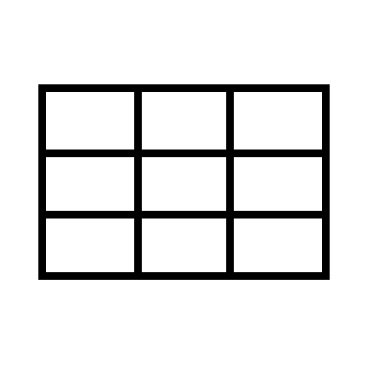


ARCHITECTURE OF CODE: MATLAB
RESULT
Prediction and Evaluation,
Acuracy,
Confusion Matrix:
BUILD & TEST
Data Splitting,
MLP network:
DATASET
Data loading and Display,
Data Verification,
Dataset Statistics Calculation,
Sample Selection,
Class Distribution,
Normalization input,
Label Encoding (One-hot Encoding)
…
…
Input: One feature for one neuron
Output: quality class (3-LOW ,9-HIGH)
1-hidden layer of linear dependencies
2-hidden layer of nonlinear dependencies

Slide 9
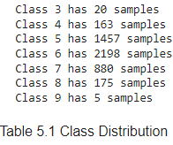
DATASET PREPARING
Raw Dataset: number of samples matters! Because in this set:
The neural network overfits the training data.
Classes 3 and 9 are ignored, and Class 6 dominates the dataset.
REMEDIES:
Oversampling:
- SMOTE creates synthetic samples of the minority class,
- Random Oversampling duplicates existing minority samples,
- Risk of overfiting,
- Balances class distribution
Undersampling:
- Removed dominant classes,
- Fastes training,
- Possible loss of important information
Manual/Define class weights
- Assign higher importance to minority classes in the loss
function
- Defining with class is important than else
- Selected samples are always in the training set

Slide 10
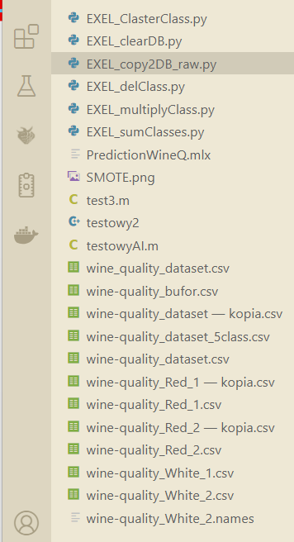
DATASET PROPOSAL FOR MODIFICATION OF INPUT DATA
OPERATIONS ON THE DATASET:
Oversampling, Upsampling, Copying to the database, Class multiplication / Replication of classes, Summation of samples within classes
TESTED DIFFERENT METHOD
DATASET:
Compared the dataset from Kaggle & github
Check different dataset Red Wine -> White Wine
Saved backup for each dataset

Slide 11
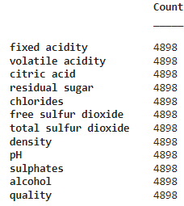
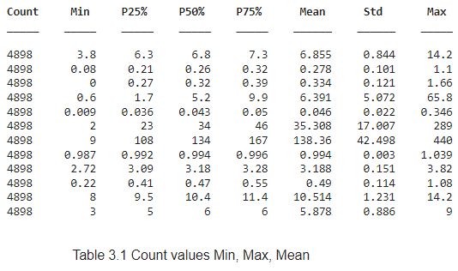

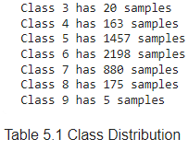
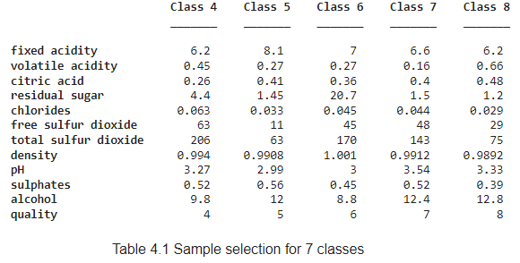

DATASET Statistics Calculation
MIX method
Added 3 -> 4
Added 9 -> 8
Undersampling class 5,6

Slide 12



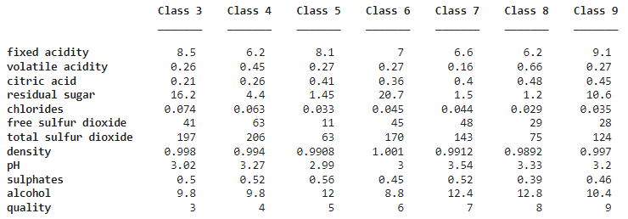
DATASET AVERAGE OF SAMPLES FOR EACH CLASS
most significant feature
less important feature
Wine score
Class 3:
Class 4:
Class 5:
Class 6:
Class 7:
Class 8:
Class 9:
fixed acidity (8.5) ↑ , Residual sugar (16.2) ↑
free sulfur dioxide (63) ↑, total sulfur dioxide (20.6) ↑, pH (3.27) ↑
alcohol (12) ↑, chlorides (0.033) ↓, density (0.9908) ↓
residual sugar (20.7) ↑ , alcohol (8.8) ↓, density (1.001) ↑
alcohol () ↑, pH (3.54) ↑, volatile acidity (0.16) ↓
sulphates (0.39) ↓, density (0.9892) ↓ , alcohol (12.8) ↑
fixed acidity (9.1) ↑, citric acid (0.45) ↑, residual sugar (10.6) ↑
Is every feature important?
RESEARCH/
knowledge building

Slide 13
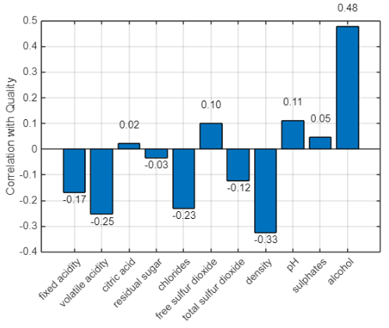
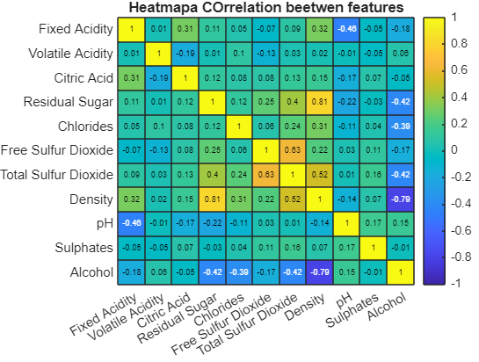
DATASET CORRELATION FOR FEATURES
The only minor difference is the weaker impact of sulphates compared to the earlier data, but it is still positive.
✅ Alcohol ➕ More alcohol = better quality
✅ Citric acid ➕ Slightly improves quality
✅ Sulphates ➕ Mild positive impact
❌ Density ➖ Strongly lowers quality
❌ Volatile acidity ➖ Reduces quality
❌ Chlorides ➖ Negative effect on quality

Slide 15
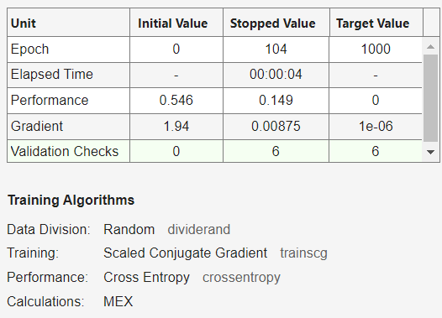
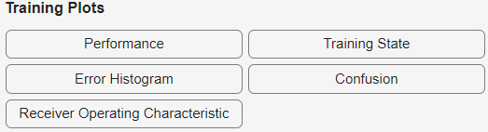
BUILDING & TEST DATA SPLITTING
MATLAB R2024b
toolbox:
Statistics and Machine
Learning & Deep Learning
FUNCTION:
%cv = cvpartition(Y_categorical, 'KFold', 5, 'Stratify', true);
cv = cvpartition(Y_cat,'Holdout',0.2);
X_train = X(training(cv),:);
Y_train = Y_encoded(training(cv),:);
X_test = X(test(cv), :);
Y_test =Y_encoded(test(cv), :);
net = patternnet([10, 5]);
net.trainFcn = 'trainscg’;
net.layers{end}.transferFcn = 'softmax’;
net.performFcn = 'crossentropy’;
net.trainParam.showWindow = false;
[net, tr] = train(net, X_train',Y_train');
1. SPLITING
2. ARCHITECTURE
3. TRAINING PROCESS
4. TRAINING PLOTS
CONFUSION MATRIX

Slide 16
%cv = cvpartition(Y_categorical, 'KFold', 5, 'Stratify', true);
cv = cvpartition(Y_cat,'Holdout',0.2);
X_train = X(training(cv),:);
Y_train = Y_encoded(training(cv),:);
X_test = X(test(cv), :);
Y_test =Y_encoded(test(cv), :);
BUILDING & TEST USED TOOLBOX
COMPARE FUNCTION FROM Statistics and Machine Learning and own function
Same result, but wider access to parameters
validClasses = unique(Y);
trainIdx = [];
testIdx = [];
holdoutRatio = 0.2;
for i = 1:length(validClasses)
classValue = validClasses(i);
classIndices = find(Y == classValue);
classIndices = classIndices(randperm(length(classIndices)));
numTest = round(holdoutRatio * length(classIndices));
testIdx = [testIdx; classIndices(1:numTest)];
trainIdx = [trainIdx; classIndices(numTest+1:end)];
end
X_train = X(trainIdx, :);
Y_train = Y_encoded(trainIdx, :);
X_test = X(testIdx, :);
Y_test = Y_encoded(testIdx, :);

Slide 17
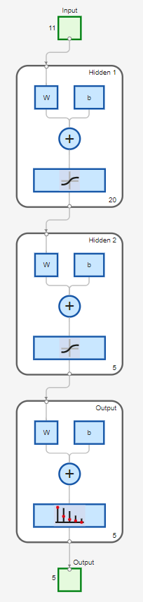
BUILDING & TEST NETWORK DIAGRAM
'imput/
features’
'weights’
'bias’
'sum’
'softmax’

Slide 18
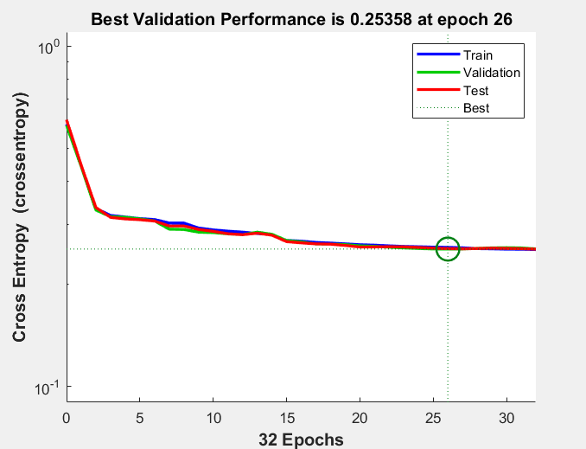
BUILDING & TEST PERFORMERS
If the validation loss starts increasing and the training loss stops improving, training should be stopped to avoid overfitting.

Slide 19
BUILDING & TEST TRAINING STATE
Learning diagnostics
High gradients, mu not decreasing
End of training session when validation is increased

Slide 20
BUILDING & TEST CONFUSION MATRIXS

Slide 21
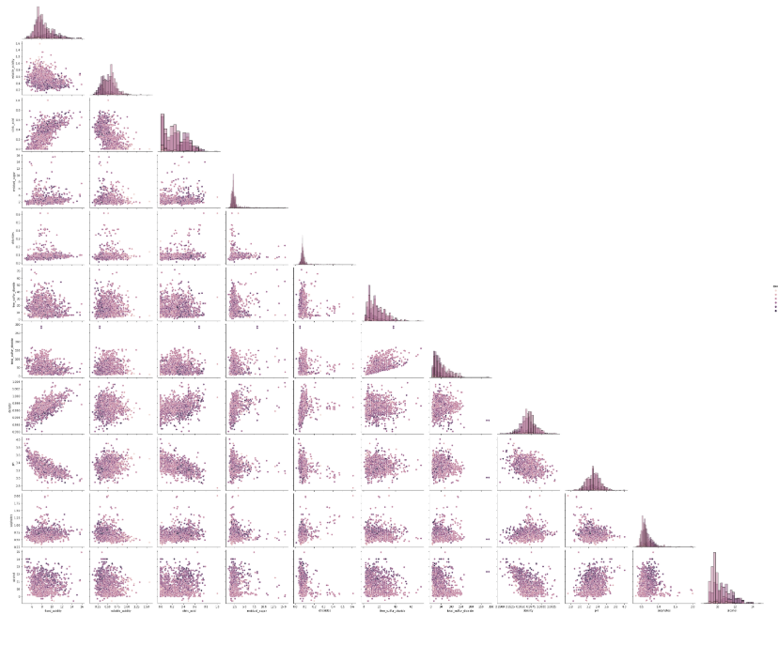
BUILDING & TEST HISTOGRAM
other developers use the PAIRPLOT, which gives more data on the histogram

Slide 22
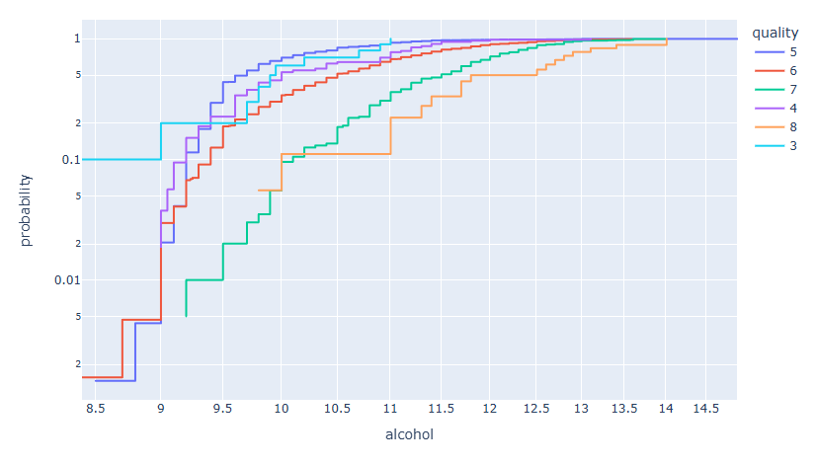
TRAINING PROCESS: RECEIVER OPERATING CHARACTERISTIC
Class 1 shows the best performance in the ROC curve. For higher classes, the curves move closer to the diagonal, which indicates weaker classification performance for those classes.
GRAPH FROM 🍷 Red Wine Quality

Slide 23
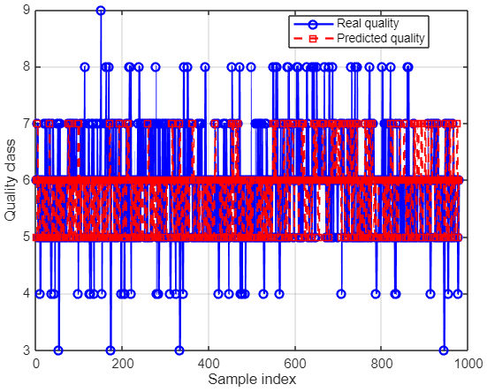
RESULT PLOT & GRAPH for 3:9 classes
OBSERVATION: NETWORK TRYED TO PUT ALL THE SAMPLES IN CLASS 6
RESULT: NETWORK IGNORED 3,4,8 and 9
classes!!

Slide 24
RESULT Reduced class to 4:8, averaging of samples
precision = diag(cm)./sum(cm,2) + eps;
cv = cvpartition(Y_cat,'Holdout',0.2);
NaN
Value Count Percent
1 732 8.41%
2 2331 26.77%
3 3517 40.39%
4 1408 16.17%
5 720 8.27%
Value Count Percent
1 586 15.63%
2 926 24.69%
3 958 25.55%
4 704 18.77%
5 576 15.36%
WORSE RESULT?

Slide 25
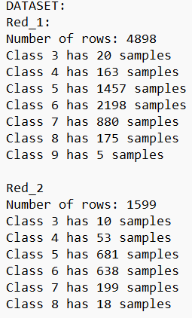
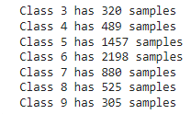



BUILDING & TEST CODING: try to used different method
Only used 2 different dataset:
Classes 3 and 9 removed, Set of 160 samples for each class
CALCULATION:
Sub database_Raw + Red_2:
?
Accuracy of network 49-53%
Undersampling class 5,6
Suggestion
Defined Class Weights
data operations were
performed using python
Oversampling clas 3,9
Accuracy of network ~50%

Slide 26
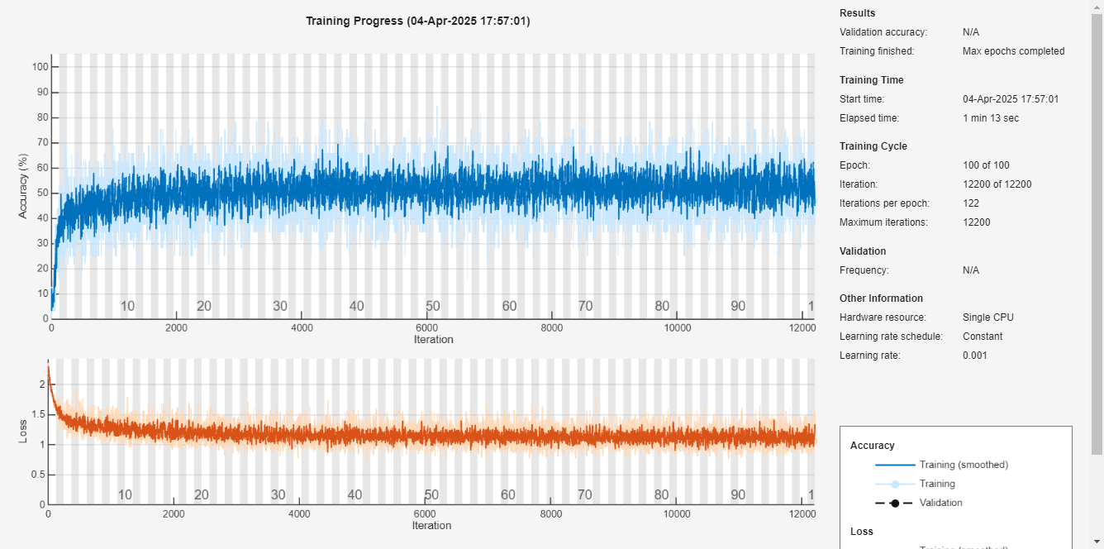
BUILDING & TEST CODING: try to used different method
SMOTE function does not help == same result as before
Accuracy of network steal ~50%

Slide 27
PRESENTATION 3

